Slide 1

Kaiqi Liao
Portfolio

Slide 2
Design Overview
Goals and Features
Showcase of what I learned so far
Identify target audience
Concise and informative
Simple and responsive design

Slide 3
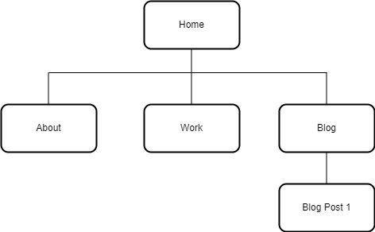
Site Map

Slide 4
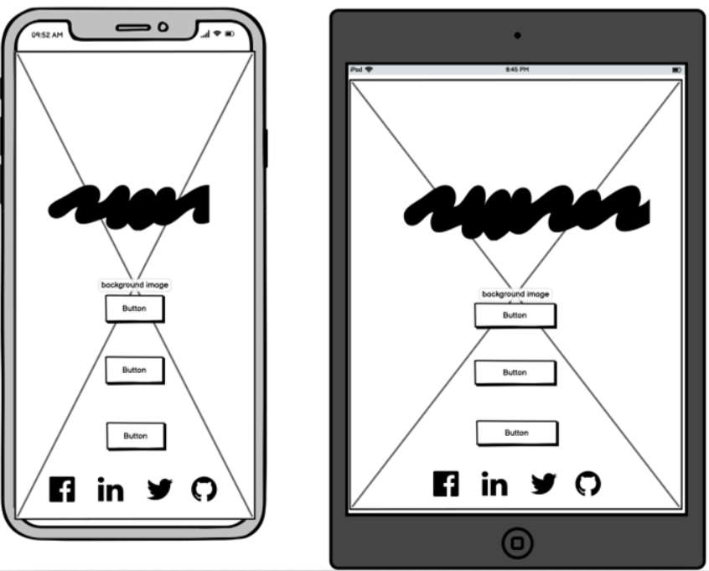
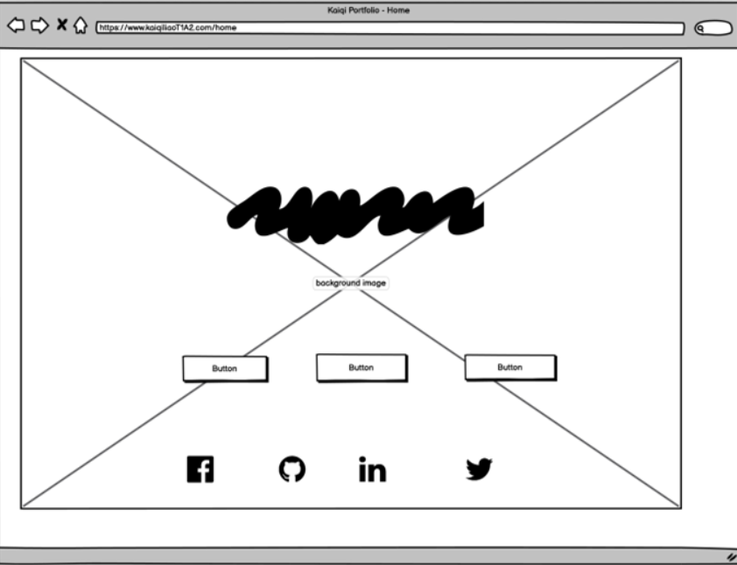
Wireframe - Home

Slide 5
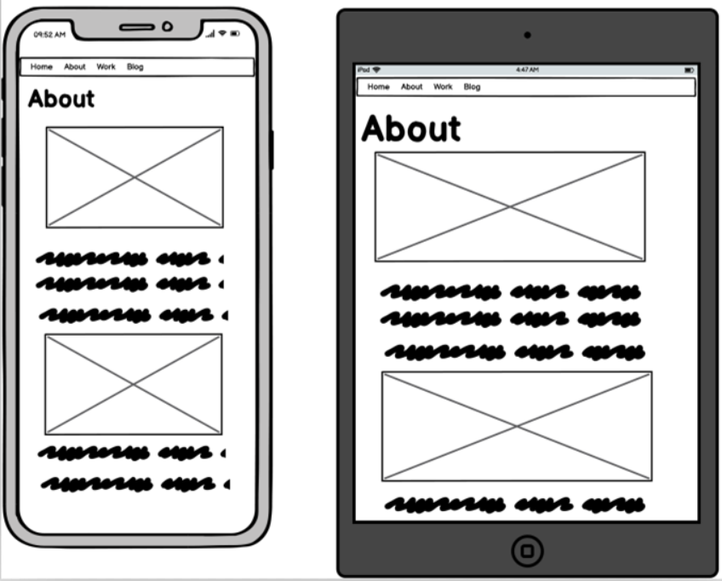
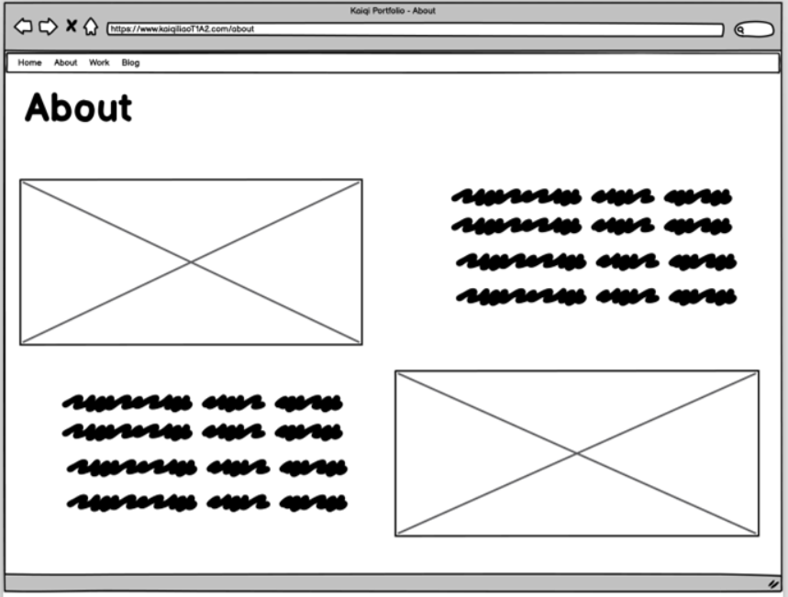
Wireframe - About

Slide 6
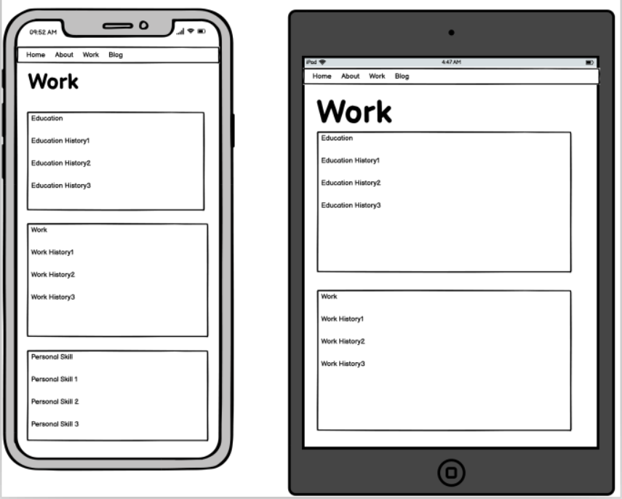
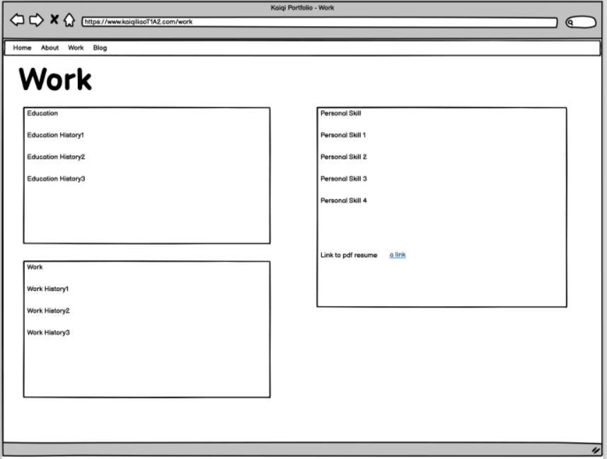
Wireframe - Work

Slide 7
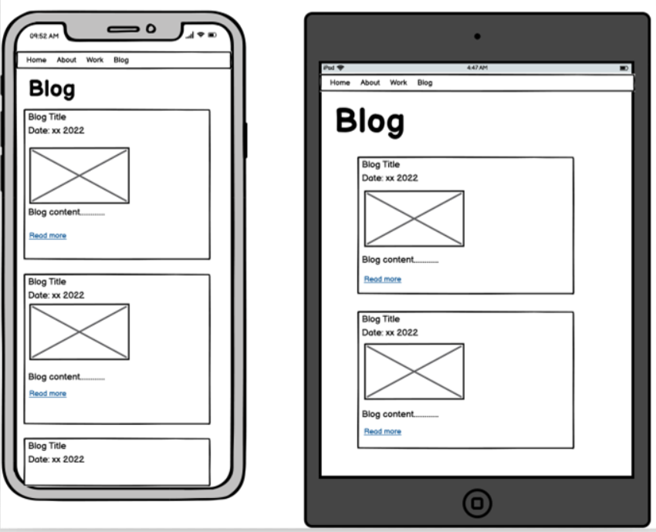
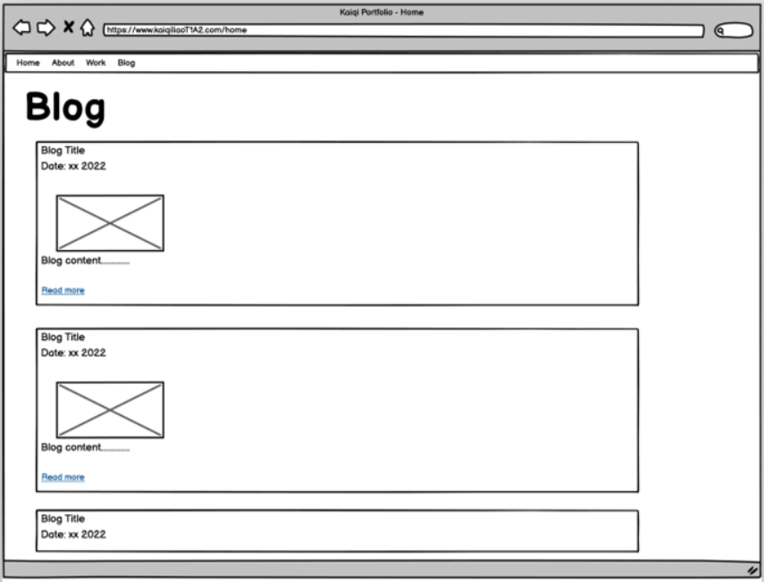
Wireframe - Blog

Slide 8
Components
Collapsible menu and navbar
Links to PDF resume
Blog card content
Social media links in footer

Slide 9
Thank You !

